Slide 1
CS4038
DATA MINING
LECTURE # 02
FALL 2024
FAST – NUCES, CFD CAMPUS
Ayesha Liaqat
ayesha.liaqat@nu.edu.pk

Slide 2
TODAY’S TOPICS
Overview of different data mining techniques
Major issues in data mining

Slide 3
WHAT IS DATA MINING?
Many Definitions:
Finding hidden information in a database
Exploration & analysis, by automatic or semi-automatic means, of large quantities of data in order to discover meaningful patterns
Non-trivial extraction of implicit, previously unknown and potentially useful information from data

Slide 4
DATA MINING VS. KDD
Knowledge Discovery in Databases (KDD): process of finding useful information and patterns in data.
Data Mining: Use of algorithms to extract the information and patterns derived by the KDD process.

Slide 5
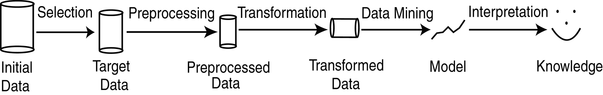
KDD PROCESS
Modified from [FPSS96C]
Selection: Obtain data from various sources.
Preprocessing: Cleanse data.
Transformation: Convert to common format. Transform to new format.
Data Mining: Obtain desired results.
Interpretation/Evaluation: Present results to user in meaningful manner.
Notes:
1)User interaction on a website, page views, clicks, timestamps
2)Remove peronally identifying/sensitive data, irrelevant data, handle missing values,
3)Transform raw data into suitable format and craft features as duration
4)Clustering
5)Visualization to represent finding
6)Evaluate the clusters or association

Slide 6
KDD PROCESS EXAMPLE:WEB LOG
Selection:
Select log data (dates and locations) to use
Preprocessing:
Remove identifying URLs
Remove error logs
Transformation:
Sessionize (sort and group)
Data Mining:
Identify and count patterns
Construct data structure
Interpretation/Evaluation:
Identify and display frequently accessed sequences.
Potential User Applications:
Cache prediction
Personalization

Slide 7
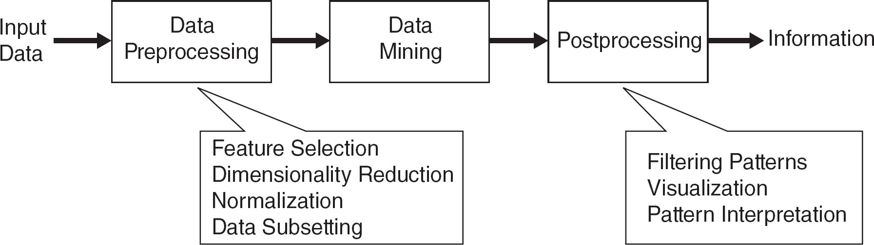
DATA MINING PIPELINE
Real-world data has quality issues.
Data preprocessing is very critical step in any project. Avid: garbage-in, garbage-out
Data preprocessing takes approximately 80% of a project’s time.
Ref: https://www.projectpro.io/article/why-data-preparation-is-an-important-part-of-data-science/242
Notes:
the quality of output is determined by the quality of the input

Slide 8
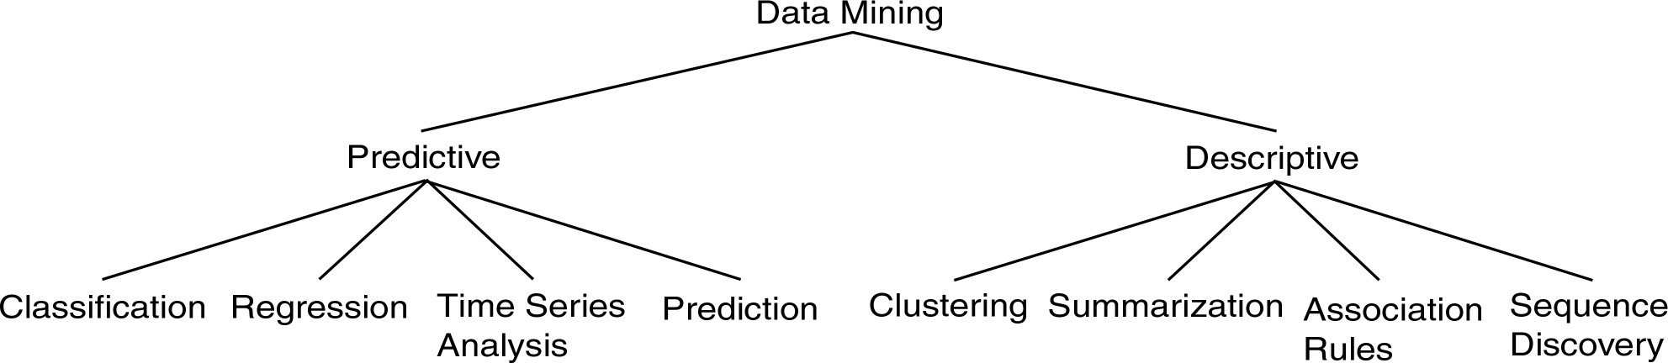
DATA MINING MODELS AND TASKS
Notes:
Regression: r/p between dependant and independent variable
Prediction: predicting a value based on other attr. Regression is its type
Time series: monthly sales of a product
Sequence discovery: web browsing: how one person works with sequence of actions/pages

Slide 9
DATA MINING METHODS
Descriptive Methods
Find human-interpretable patterns that describe the data.
Prediction Methods
Use some variables to predict unknown or future values of other variables.

Slide 10
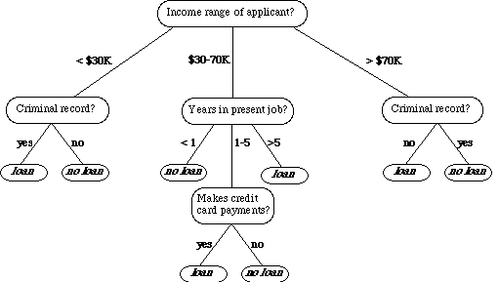


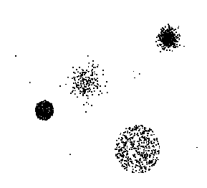


DATA MINING TASKS
Data
Clustering
Tid | Refund | Marital Status | Taxable Income | Cheat
1 2 3 4 5 6 7 8 9 10 11 12 13 14 15 | Yes No No Yes No No Yes No No No No Yes No No No | Single Married Single Married Divorced Married Divorced Single Married Single Married Divorced Single Married Single | 125K 100K 70K 120K 95K 60K 220K 85K 75K 90K 60K 220K 85K 75K 90K | No No No No Yes No No Yes No Yes No No Yes No Yes
Predictive Modeling
Association
Anomaly
Detection
Rules
10
Milk

Slide 11
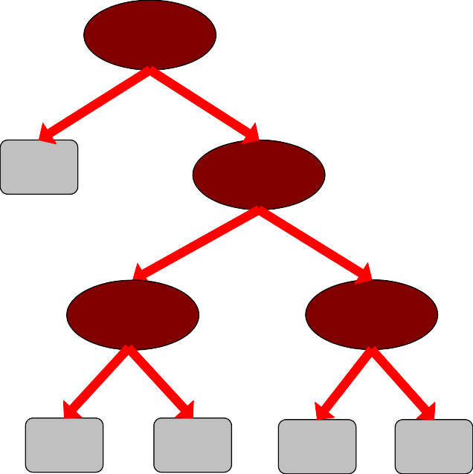
PREDICTIVE MODELING: CLASSIFICATION
Model for predicting credit worthiness
Find a model for class attribute as a function of the values of other attributes
Employed
Class
No
Yes
Tid | Employed | Level of Education | # years at present address | Credit Worthy
1 | Yes | Graduate | 5 | Yes
2 | Yes | High School | 2 | No
3 | No | Undergrad | 1 | No
4 | Yes | High School | 10 | Yes
… | … | … | … | …
No
Education
Graduate
{ High school, Undergrad }
Number of years
Number of years
7 yrs < 7 yrs
10
3 yr
< 3 yr
Yes
No
Yes
No

Slide 12
CLASSIFICATION EXAMPLE
Tid | Employed | Level of Education | # years at present address | Credit Worthy
1 | Yes | Undergrad | 7 | ?
2 | No | Graduate | 3 | ?
3 | Yes | High School | 2 | ?
… | … | … | … | …
categorical
categorical
quantitative
class
Tid | Employed | Level of Education | # years at present address | Credit Worthy
1 | Yes | Graduate | 5 | Yes
2 | Yes | High School | 2 | No
3 | No | Undergrad | 1 | No
4 | Yes | High School | 10 | Yes
… | … | … | … | …
10
Test Set
10
Learn
Classifier
Training Set
Model

Slide 13



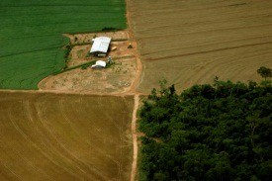
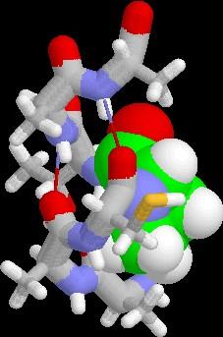
EXAMPLES OF CLASSIFICATION TASK
Classifying credit card transactions as legitimate or fraudulent
Classifying land covers (water bodies, urban areas, forests, etc.) using satellite dat
Categorizing news stories as finance, weather, entertainment, sports, etc.
Identifying intruders in the cyberspace
Predicting tumor cells as benign or malignant
Classifying secondary structures of protein as alpha-helix, beta-sheet, or random coil
a

Slide 14
CLASSIFICATION: APPLICATION 1
Fraud Detection
Goal: Predict fraudulent cases in credit card transactions.
Approach:
Use credit card transactions and the information on its account-holder as attributes.
When does a customer buy, what does he buy, how often he pays on time, etc.
Label past transactions as fraud or fair transactions.This forms the class attribute.
Learn a model for the class of the transactions.
Use this model to detect fraud by observing credit card transactions on an account.

Slide 15
CLASSIFICATION: APPLICATION 2
Churn prediction for telephone customers
Goal: To predict whether a customer is likely to be lost to a competitor.
Approach:
Use detailed record of transactions with each of the past and present customers, to find attributes.
How often the customer calls, where he calls, what time-of-the day he calls most, his financial status, marital status, etc.
Label the customers as loyal or disloyal.
Find a model for loyalty.
From [Berry & Linoff] Data Mining Techniques, 1997

Slide 16
REGRESSION
Predict a value of a given continuous valued variable based on the values of other variables, assuming a linear or nonlinear model of dependency.
Extensively studied in statistics, neural network fields.
Examples:
Predicting sales amounts of new product based on advertising expenditure.
Predicting wind velocities as a function of temperature, humidity, air pressure, etc.
Time series prediction of stock market indices.

Slide 17
CLUSTERING
Finding groups of objects such that the objects in a group will be similar (or related) to one another and different from (or unrelated to) the objects in other groups
Inter-cluster distances are maximized
Intra-cluster distances are minimized

Slide 18
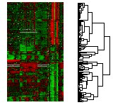
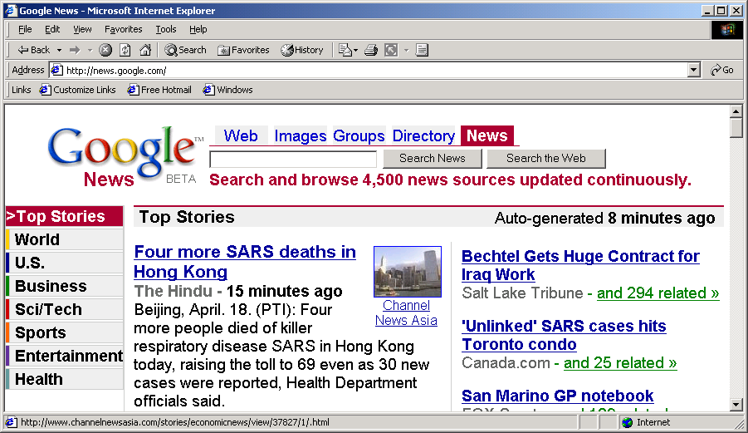
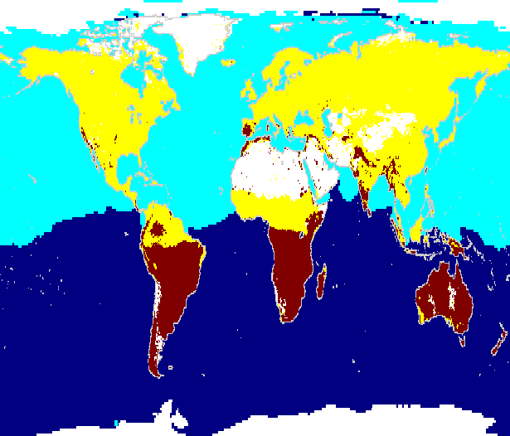
APPLICATIONS OF CLUSTER ANALYSIS
Understanding
Custom profiling for targeted marketing
Group related documents for browsing
Group genes and proteins that have similar functionality
Group stocks with similar price fluctuations
Summarization
Courtesy: Michael Eisen
Reduce the size of large data sets
Clusters for Raw SST and Raw NPP
Use of K-means to partition Sea Surface Temperature (SST) and Net Primary Production (NPP) into clusters that reflect the Northern and Southern Hemispheres.
90
60
Land Clus
30
Land Clus
latitude
0
-30
Ice or No
-60
Sea Clust
-90
Sea Clust
-180 -150 -120 -90 -60 -30 0
30 60 90 120 150 180
Cluster
longitude
23

Slide 19
CLUSTERING: APPLICATION 1
Market Segmentation
Goal: subdivide a market into distinct subsets of customers where any subset may conceivably be selected as a market target to be reached with a distinct marketing mix.
Approach:
Collect different attributes of customers based on their geographical and lifestyle related information.
Find clusters of similar customers.
Measure the clustering quality by observing buying patterns of customers in same cluster vs. those from different clusters.

Slide 20
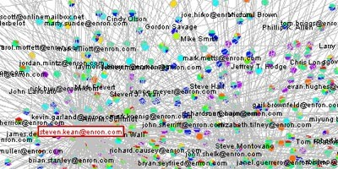
CLUSTERING: APPLICATION 2
Document Clustering:
Goal: To find groups of documents that are similar to each other based on the important terms appearing in them.
Approach: To identify frequently occurring terms in each document. Form a similarity measure based on the frequencies of different terms. Use it to cluster.
Enron email dataset

Slide 21

ASSOCIATION RULE DISCOVERY: DEFINITION
Given a set of records each of which contain some number of items from a given collection
Produce dependency rules which will predict occurrence of an item based on occurrences of other items.
TID | Items
1 | Bread, Coke, Milk
2 | Beer, Bread
3 | Beer, Coke, Diaper, Milk
4 | Beer, Bread, Diaper, Milk
5 | Coke, Diaper, Milk
Rules discovered:
{Milk} --> {Coke}
{Diaper, Milk} --> {Beer}

Slide 22
ASSOCIATION ANALYSIS: APPLICATIONS
Market-basket analysis
Rules are used for sales promotion, shelf management, and inventory management
Telecommunication alarm diagnosis
Rules are used to find combination of alarms that occur together frequently in the same time period
Medical Informatics
Rules are used to find combination of patient symptoms and test results associated with certain diseases

Slide 23

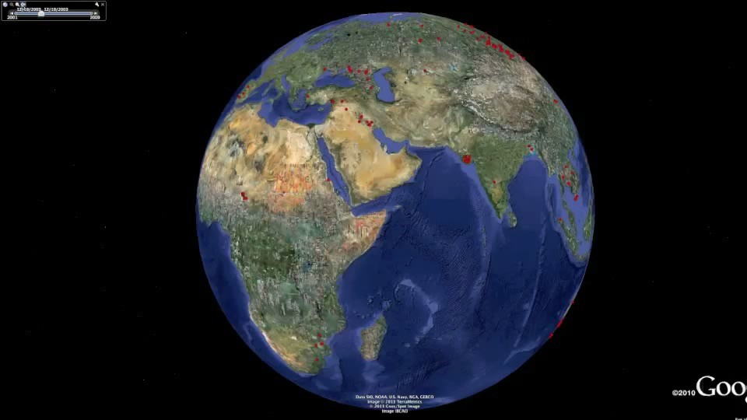
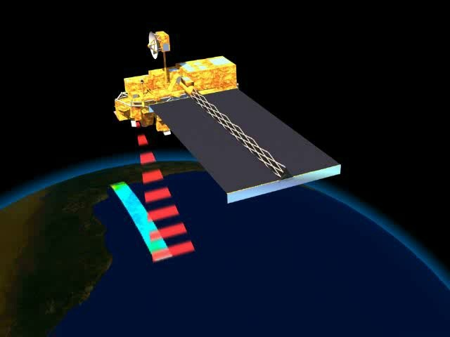
DEVIATION/ANOMALY/CHANGE DETECTION
Detect significant deviations from normal behavior
Applications:
Credit Card Fraud Detection
Network Intrusion Detection
Identify anomalous behavior from sensor networks for monitoring and surveillance.
Detecting changes in the global forest cover.

Slide 24
MAJOR ISSUES IN DATA MINING (1)
Mining Methodology
Mining various and new kinds of knowledge
Mining knowledge in multi-dimensional space
Data mining: An interdisciplinary effort
Boosting the power of discovery in a networked environment
Handling noise, uncertainty, and incompleteness of data
Pattern evaluation and pattern- or constraint-guided mining
User Interaction
Interactive mining
Incorporation of background knowledge
Presentation and visualization of data mining results
Notes:
Mine text data: dm+IR+NLP
Not all patterns are interesting
Provides Flexible UI+exploratory mining environments

Slide 25
MAJOR ISSUES IN DATA MINING (2)
Efficiency and Scalability
Efficiency and scalability of data mining algorithms
Parallel, distributed, stream, and incremental mining methods
Diversity of data types
Handling complex types of data
Mining dynamic, networked, and global data repositories
Data mining and society
Social impacts of data mining
Privacy-preserving data mining
Invisible data mining
Notes:
Running time of algo must be short,predictable and acceptable by algo.
Big data, high dimensions,distribution lead to parallel and incremental systems. So Data partitioned into pieces. Each piece processed in parallel to search patterns and then merged.
Different data types available so one mining system cant perform so domain/app dedicated systems are used to deal with.
Identify dm To benefit society, misuse
Invisible:one can use without knowledge

Slide 26
https://media.geeksforgeeks.org/wp-content/uploads/20200620112550/auto2.png

Slide 27
DATA MINING RESOURCES
ACM SIGKDD https://www.kdd.org
Annual KDD conference: keynotes, research, applied data science, workshops, tutorial, KDD CUP, …
KDnuggets https://www.kdnuggets.com
Many more…

Slide 28
READING MATERIAL
Chapter 1:Tan, Steinbach & Kumar
Chapter 1: Han, Kamber & Pei
Chapter 1: Dunham
How Data Mining is different from Machine Learning?

